Slide 1
Virtual Battles: Cyberbullies
Chapter 3

Slide 2
Learning Objectives
Students will:
Learn about the different types of cyberbullying
Learn about the technological tools of the cyberbully
Learn about the negative effects of cyberbullying
Discuss prevention and coping skills
Learn about positive social changes that can occur when teens use their experiences with cyberbullying to educate others

Slide 3
Key Terms
Cyberbullying
Harassment
Flaming
Outing
Degradation
Deception
In-person bullying

Slide 4
What is Cyberbullying?
Cyberbullying usually occurs when digital messages are used to threaten, torment, or embarrass someone.
Those who cyberbully typically use everything from cell phones to social media to spread hateful comments that can sweep across cyberspace in seconds.
Cyberbullying is a serious issue in today’s society.

Slide 5
Common Types of Cyberbullying
Common Types include:
Harassment – repeatedly sending mean messages with an offensive meaning
Flaming – insulting someone in an online discussion using ugly and cruel language
Outing – revealing someone’s private thoughts, secrets or personal information
Degradation – spreading lies and rumors using digital tools
Deception – stealing someone’s passwords and using them to commit fraud

Slide 6
Technological Tools of Cyberbullying
In most Cyberbullying cases, social media tools are used to deliver vicious and repetitive messages. The five most common tools used are:
Emails
Websites
Text messages
Instant messages
Forums and chat rooms

Slide 7
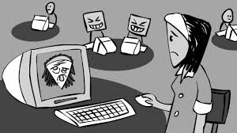
In-Person Bullying vs. Cyberbullying
So What is the Difference?
People often respond differently to in-person bullying than they do to cyberbullying.
Cyberbullies use computers and other technology to do damage to others from a distance instead of face-to-face.
Cyberbullies also find ways to torment others while remaining anonymous so others do not know who is behind the behavior.

Slide 8
In-Person Bullying vs. Cyberbullying (cont.)
Characteristics of Cyberbullying
False digital accounts or multiple screen names make it easy for bullies to remain anonymous.
Cyberbullying can follow people home, which can take away the pace where many teens feel most safe.
Cyberbullying knows no limits, because messages can be publicly shared through social media, and they can be seen by people around the world.
Hiding behind a screen sometimes gives bullies more confidence to say things they wouldn’t say in person.

Slide 9
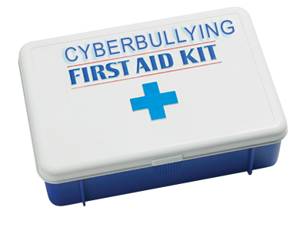
Coping with Cyberbullying
The following are 5 strategies that will help someone cope with cyberbullying in a more constructive way.
Tell a trusted adult to help you process what is going on.
Don’t seek revenge to right a wrong.
Report the incident to the service provider.
Block communication from the bully.
Maintain positive online safety habits by
creating strong passwords and avoid sharing
private information.

Slide 10
Preventing Cyberbullying
The following are steps you can take to avoid becoming a cyberbully or becoming victim to one.
Protect your information
Respect your peers both on and off-line
Be the bigger person and walk away
Don’t participate
Help raise awareness
Never text or post photos you wouldn’t want parents or teachers to see
Fact!
Did You Know?
80% of teens say they have defended a victim of cyberbullying, and 79% have asked a cyberbully to stop.

Slide 11
Negative Effects of Cyberbullying
Those who fall victim to cyberbullying deal with very tough mental and emotional wounds. Many teens who encounter cyberbullying struggle with the issues listed below:
Stress and anxiety
Sadness and loneliness
Depression
Loss of interest in activities
Fear
Drop in grades
Low self-esteem
Low self-confidence
Health problems
Change in eating or sleeping patterns
Use of alcohol or drugs
Thoughts of suicide

Slide 12
Positive Social Change
While falling victim to cyberbullying is hurtful and bad for our health, some teens use their experiences to promote positive social change and provide encouragement. Two common ways to turn promote a positive social change is to:
Share stories:
Talk about your experiences with adults, friends, or a counselor
Promote awareness:
Publicly speak out on the issue
Work to change negative online behavior

