Slide 1
Protecting What’s Yours: Your Identity
Chapter 4

Slide 2
Learning Objectives
Learn about identity thieves, the type of information they steal, and how they accomplish identity theft
Learn how staying safe online, like creating strong passwords, will help to avoid identity theft
Discuss what to do if identity is compromised

Slide 3
Key Terms
Identity theft
Identity thieves
Private information
Personal information
Passwords

Slide 4
What is Identity Theft?
Identity Theft is when private information is stolen and used without permission.
Your private information, such as full name and Social Security number, is stolen and used without permission
Thieves use cyberspace to find and steal identities

Slide 5
How Identity Theft is Accomplished
Being clever, they can use the following to obtain your information:
Phone calls – pretend to work for a legitimate company that we trust, or act as though they are a friend in order to obtain our private information.
Phishing – used when thieves send out emails asking for private information. Can also contain links that once clicked on will release a virus on your computer.
Public computers – are typically vulnerable when left logged in accidentally providing thieves with access to private information.

Slide 6
What are They Stealing?
While not every thief uses stolen information in the same way, many use the stolen data in the ways listed below:
Gain access to your bank accounts
Take out a loan in your name
Open credit card accounts in your name
Open utility accounts in your name
Seek medical assistance using your name
Hijack, or take over, your email account

Slide 7
Private vs. Personal Information
While the terms private and personal have similar meanings, there is a difference between the two in cyberspace.
Private Information consists of the following:
Full name
Social Security number
Birth date
Address and phone number
Account passwords
Credit card numbers
Bank account numbers

Slide 8
Personal Information
Information that doesn’t necessarily identify who you are is considered personal information.
Examples include:
Favorite sports
Favorite music
Opinions on movies
Advice on a topic
Favorite book
Fact!
Did You Know?
In 2012, about 16.6
million people—about 7%
of U.S. citizens age 16 or
older—were victims of
identity theft.

Slide 9
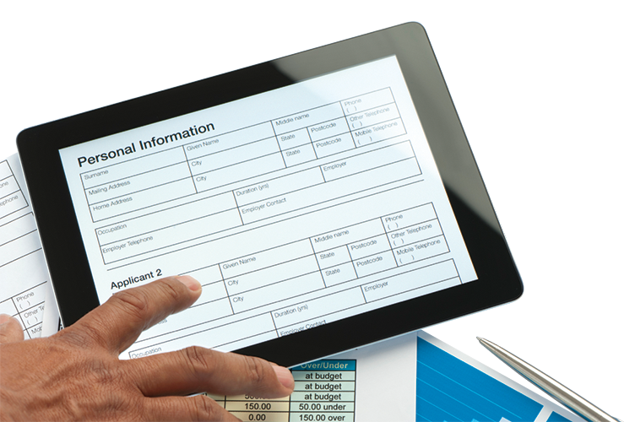
Safe Sharing of Private Information
Private information may be required when doing the following:
Applying for a driver’s license
Paperwork for a new job
Preparing tax information
Applying for a bank loan
Opening a new bank account

Slide 10
Stay Safe by Staying Alert
Create strong passwords
Never share passwords
Don’t share private information
Be careful sharing on social networks
Monitor online accounts frequently
Report questionable activities on your accounts
Always log out of private accounts

Slide 11
Create Strong Passwords
Don’t use any self-identifying facts
Avoid using obvious facts about yourself
Make passwords of at least eight characters
Include a combination of numbers, symbols, and letters
Change your passwords every few months
Create passwords that you will remember
Don’t enter passwords into your phone
Don’t type your passwords in a public place

Slide 12
What if Your Identity is Compromised?
Steps to take:
Report it
Close it
Watch it

