Slide 1
Hacker’s Heaven: Computer Threats
Chapter 5

Slide 2
Learning Objectives
Students will:
Become familiar with many types of malware
Understand Trojan Horses, worms, spyware, and adware
Learn about Spam
Identify hacker techniques such as phishing, pharming, and using pop-ups

Slide 3
Hackers and Threats
Computer Threats
Breaches of security causing harm to a computer
Once a computer is breached, its software and files can be corrupted, while personal information stolen and used for criminal gain.
Hackers/Cybercriminals
People who “hack” or break into computer systems
Use unauthorized means to break into computers - typically by stealing personal information
Cybercriminals are hackers that commit financial crimes

Slide 4
Hackers and Threats (cont.)
Hackers and cybercriminals are not the only threats that can inflict damage to computer systems. The following malware causes just as much damage:
Viruses
Trojan horses
Worms
Spyware
Adware
The consequences of being infected can be serious and cause great consequences.

Slide 5
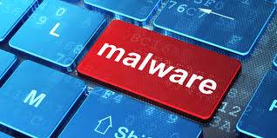
Malware
Malware is known as one of the most common types of computer threats around.
It gets its name from “mal” meaning malicious, “ware” meaning software.
Hackers and cybercriminals use codes such as these to invade someone’s personal computer and steal private information and/or disrupt computer operations.

Slide 6
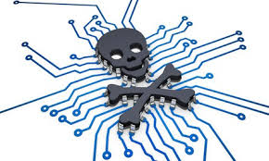
Viruses
These are computer programs that replicate and spread from one computer to another.
Ex: A friend of yours sends you an email that includes an attachment. Unknown to your friend, it is infected with a virus and you open it. You have now opened the door to damage and infection to your computer.
Viruses typically attach themselves to existing computer programs (Host Program) & files. It then modifies the program
This is referred to as “piggybacking”
Viruses protect themselves by hiding in a host program

Slide 7
Viruses, cont.
They can damage hardware, software, and files.
The malicious activity that viruses carry out is known as a ‘Payload’
Typically unlock and invade by human action.
Running the Host Program or clicking on a file or link to a file.
The virus can remain dormant in a computer until the program or file is opened by the user.
Can affect different parts of a computer:
Hard Drive, CD/DVD Drive, any Storage Device
Examples of spreading medians:
Internet, Downloading Music or Attachments, Thumb Drive

Slide 8
Worms
An independent program which multiplies itself by copying a segment of itself onto another computer
Similar to viruses, but do not need humans to activate and spread. It does not attach to programs.
They spread through computer networks instead of existing programs.
Worms can infect an entire network of computers within seconds.
Issues include: taking up bandwidth and slowing down or crashing servers and personal computers.

Slide 9
Worms, cont.
Two classifications of Worms: Network and Host
A network worm copies different segments of itself to computers linked together on a network.
If one segment of the worm fails or is removed, the other remaining segments find a computer, prepare it for the worm, and then add the segment to the rest of the worm
A host worm copies itself to another computer in a network and then deletes itself completely from the previous computer in which it was contained.
Originates from one running computer
Does not fragment or segment itself like a network worm

Slide 10
Viruses and Worms: Similarities
Both Include:
contain malicious instructions designed to harm a computer and annoy a user
the more computers the worms or viruses infect the more computers they have access to infect by networking
protect themselves by hiding in host programs or changing their appearance to evade detection
destroy evidence of their presence and wrongdoings
spread through a network, the Internet, software, e-mails or memory devices (such as a rewritable CD)
cause system or network slowdowns

Slide 11
Viruses and Worms: Differences
Include:
a virus requires a host program
a worm is an independent program
a virus modifies other programs
a worm usually does not
a virus only executes when the host program is running
a worm is always active
a virus uses host programs to replicate
a worm replicates itself over a network
a virus needs to be activated or downloaded
a worm does not need to be activated

Slide 12
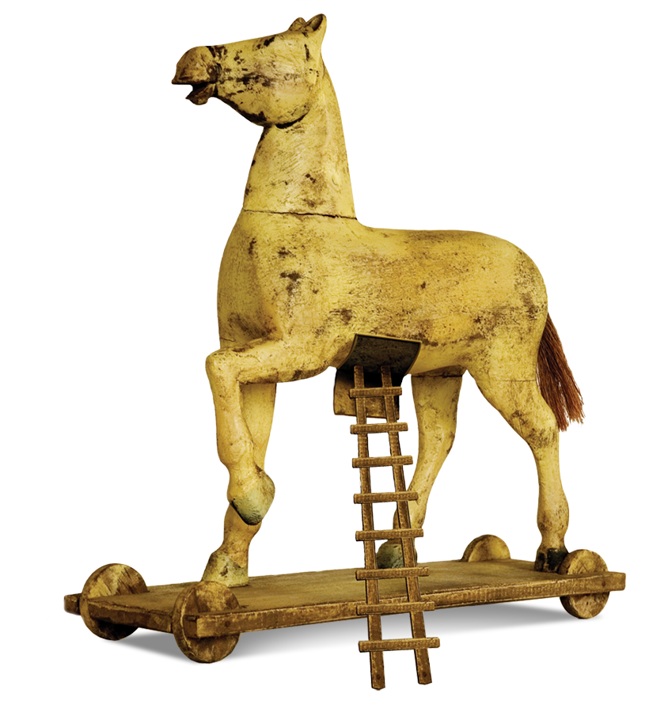
Trojan Horses
These are files or programs that attach themselves to a computer for purposes of hacking personal information or interrupting your computer use.
It is easy to infect your computer with these types of files because they typically look similar to other legit or actual software programs/files.
Do not replicate like viruses or worms, but do cause great havoc to the host computer.
Some Trojan horses allow hackers and cybercriminals remote access to your computer to gain control of personal files and accounts.

Slide 13
Trojan Horses, cont.
Gain access to administrative areas on a computer
once it has gained access to these areas, it will create a back door which provides unauthorized access to the user’s information.
Will sometimes monitor keystrokes and browsing activity
information is sent to companies sending the user content they did not request
Can be discreet
they do not leave any trace of their presence

Slide 14
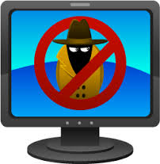
Spyware
Another type of malware that collects information without the knowledge of the computer user.
Is often attached to software or files that a user downloads from an email or file from the Internet.
Ex: music and movies from shared files
Similar to Trojan horses and can track keystrokes from Internet searches, log-in info, bank account info and other private data
Most Spyware is used illegally, but some is used
for legitimate purposes.
Used on business or work computers to monitor employee usage.

Slide 15
Adware
Adware is advertising software that is intended to make money for the creator of the advertisement.
Typically comes with bundled, free software (freeware) that does not charge the user, but requires you to view the advertisements first before the software can be used.
Is sometimes accompanied by spyware which allows the creator to spy on user activity.

Slide 16
All About Spam
Spam is considered the junk of email.
It is unsolicited messages sent to a large group of people in an attempt to get a user to provide personal information such as names, addresses and even bank account information.
Most spam is communicated sent through email or other communication services.
Often times the offers that sound too good to be true, are normally too good to be true!

Slide 17
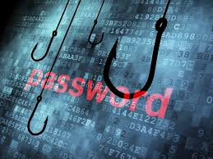
Phishing
Hackers and cybercriminals often use other forms of malware to gain access to your private information.
Phishing occurs when someone sends you an email that “fishes” for your private information, hoping that you bite and provide them with it.
Often mimic sites that look legitimate and real.
Cybercriminals pose as representatives of legitimate companies hoping to trick you into giving them your information.

Slide 18
Pharming
Pharming is a tactic that hackers and cybercriminals use to secretly redirect users to a different website from the one they think they are visiting.
Ex: someone logs into their bank’s website and is redirected to a webpage that looks similar to the banks.
Purpose is to seek out private information such as bank accounts and other financial services.
If obtained, users can face severe financial repercussions.

Slide 19
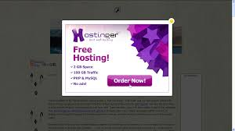
Pop-ups
Pop-up messages can appear out of nowhere while a user surfs the web.
Pop-ups are similar to advertisements, which are part of phishing schemes.
They are sometimes used by software companies to display important information or to perform specific tasks.
If a Pop-up is trying to sell you something, it’s usually a bad idea to click on it!

Slide 20
What Happens After an Attack?
Once computers become infected with malware, there are multiple dangers that a user must contend with.
Common symptoms after a malware attack:
Computer crashes
Computer slowdowns
Corrupted files
Frozen applications
Stolen private information

Slide 21
Attack Aftermath
If infected with any type of malware:
Computer could be turned into a zombie
Zombie computers are used to transmit malware to other computers without your knowledge.
A bot is a program that automatically performs tasks on the Internet without your knowledge
If your computer is used as a zombie, your computer is helping hackers and cybercriminals form a botnet.
A network including many computers that are infected.

Slide 22
Fact! Did You Know?
After hijacking White House computers in 1999, a 19-year-old hacker was sentenced to 15 months in federal prison, $36,240 in fines, and restricted computer use for at least three years.

Slide 23
The History of the Computer Virus
Began in 1949 when John Von Neumann wrote a paper called “Theory and Organization of Complicated Automata”
this paper assumed a computer program could self-replicate
this theory was later called “Core Wars”
Became a reality in 1982 when the first virus called the “Elk Cloner” was created by Rich Skrenta
The virus created by Skrenta was created as a prank on his friends. He modified floppy disks containing games or software which were swapped within his group of friends. Instead of running the software or game the disk displayed taunting messages.

Slide 24
The History of the Computer Virus (cont.)
Viruses progressed in the 80’s and 90’s, when hackers developed new ways to steal information and inhibit regular computer use
The ‘Elk Cloner’ Virus:
Was created as what is now known as a boot sector virus
a copy of the virus is downloaded off of a disk when the computer is booted up
then when someone else inserts a disk into the computer, the virus is downloaded to the new disk
Began as an innocent prank
however this prank opened the door for numerous, harmful viruses to be created

Slide 25
The History of the Computer Virus (cont.)
The ‘Brain’:
Created in 1986 in Pakistan by brothers Basit Amjad and Farooq Alvi
This was a boot sector virus and technically the first stealth virus
Stealth Virus: a virus in which if anyone attempts to view an infected sector, the virus will replace it with the clean, original version of the sector
Boot Sector Virus: a virus which copies itself onto a computer off of a disk when the computer is booted up; then when someone else inserts a disk into the computer, the virus is downloaded to the new disk.

Slide 26
The History of the Computer Virus (cont.)
The ‘Vienna Virus’:
Developed by hackers experimenting with other ideas of viruses and then building on them
The Vienna Virus was picked apart by Ralph Burger who wrote a book called Computer Viruses: A High Tech Disease
The book explained the process of creating a virus
Was widely publicized
Made computer viruses popular, and hackers began widely creating and distributing viruses

Slide 27
The History of the Computer Worm
Computer Worms Begin with the idea of computer viruses
Made its first significant stride around 1980 when researchers at Xerox Palo Alto Research center developed the first worm for experimental research
this worm was developed to handle mail, administer diagnostics and execute other functions
was created without malicious intentions

Slide 28
The History of the Computer Worm (cont.)
The ‘Morris Worm’:
Created by Robert Morris in 1988
The first worm distributed over a network without the users being aware
Designed for experimental purposes, & was released onto a network to remain present without negatively affecting the network.
Began clogging the network
Affected approx. 6,000 servers and caused between $10 million to $100 million dollars worth of damage
Robert Morris went on trial and was convicted (probation & fine)

Slide 29
The History of Viruses & Worms – Timeline
Important Viruses & Worms in History (starting in 1993)
1993 – The “SatanBug” was created and was devastating to many computers
the FBI investigated and discovered the creator was a child
1996 – The “Concept Virus” was released and devastated the computer world
first virus widely affecting Word® documents
1999 – The “Melissa Worm” was released
this macro devastated many commercial organizations because of their high usage of Word® and Excel®
2001 – “Code Red” worm was discovered
provided control of the Web server to anyone who knew the security had been compromised

Slide 30
Laws Against Computer Viruses & Worms
Laws exist at both the state and federal level
meaning a hacker can be prosecuted at the state level if the virus did not leave the state or at the federal level if it crossed state boundaries
The U.S. Secret Service will investigate if case goes to the federal level
Usually considered a felony
Began in 1986 with the Computer Fraud and Abuse Act
the punishment varies depending on:
the amount of damage caused by the worm, if the amount of damage caused was intentional, if the worm or virus was created for commercial advantage or personal financial gain
Punishment is imprisonment for up to 20 years and/or a fine

Slide 31
Laws Against Computer Viruses & Worms
Computer Fraud and Abuse Act was amended in 1994 and 1996
it was amended because of:
innovative worms and viruses
clarification issues
the fines and punishments remained the same
Clarification Issues arose from distinguishing whether something was a worm, virus or Trojan horse
the legislation was amended so all of the above would fall under the following statement

