Slide 1
Homeland Security: Computer Protection
Chapter 6

Slide 2
Learning Objectives
Students will:
Learn how to use computer security methods
Learn how to use critical thinking skills to protect computer from threats
Learn the importance of backing up their computer
Learn the importance of updating security methods regularly

Slide 3
What is Computer Protection?
Can be defined as:
Using a combination of methods to safeguard your computer’s information from theft and other harmful attacks.
Two security methods to protect your information:
Firewalls
Antivirus Software

Slide 4
Security Methods
Firewall:
Stands between your computer’s network and the Internet
Protects against unauthorized access to your network
Decides who to let in and what to keep out
Antivirus software:
Searches for and removes malware
Prevents malware from attaching
Keeps viruses, worms, and Trojan Horses safely away from your files and applications

Slide 5
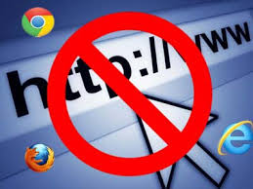
Security Methods (cont.)
Example
Most schools use a firewall to protect students from visiting inappropriate websites and from receiving harmful emails, such as spam.

Slide 6
Shields of Protection
Making sure firewalls and antivirus software are in place are a great first step toward protecting your computer from potentially dangerous threats.
The four P’s of Protection:
Protect
Prevent
Prepare
Perceive

Slide 7
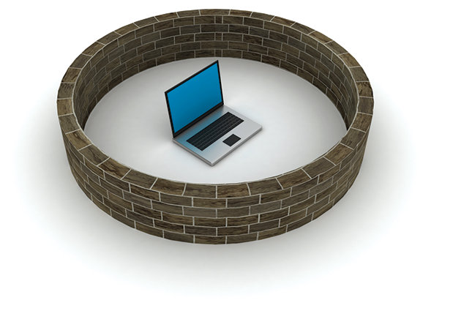
Protect
Safeguarding your computer means putting into action the best available tools to secure and protect it from malicious attacks.
Security methods to use regularly:
Use a firewall to protect your network
Use antivirus software and keep it up
to date
Keep your operating system updated
with the latest protection
Be careful what you download, transfer
or save from the Internet

Slide 8
Did You Know?
In 2000, a 16 year-old (Jonathan James) resident of Miami, Florida, became the first juvenile to be sentenced for a federal computer crime after hacking into NASA’s computer system. He was sentenced to 6 months in juvenile detention. Had he been an adult, his crimes would have constituted felonies and drawn a sentence of 10 years or more.

Slide 9
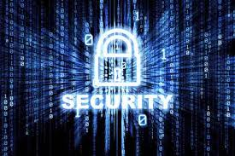
Prevent
Preparing for the worst may seem unnecessary, but taking a few precautionary steps may help keep your computer protected from the unknown.
Prevention may include:
Back up your files regularly
Research which back-up method is
right for you
Turning off your computer when done
helps keep hackers at bay

Slide 10
Prepare
The best way to protect your computer is to stay informed about the latest computer security methods and to update your security programs regularly.
Preparation means:
Stay informed about the latest computer security methods
Check for updates to security programs, software, and operating systems
Report suspicious activity to your Internet service provider

Slide 11
Perceive
Not only does it help to be knowledgeable about the latest computer security programs, but it also pays to use your instincts whenever you encounter uncertain situations.
Things to do:
Use critical thinking skills to assess potential dangers
Watch for warning signs that might indicate
presence of malware
Exercise good judgment
Evaluate online encounters

Slide 12
What Else Can I Do to Protect Myself?
Use good judgement and common sense while surfing the web. Do not accidentally give hackers a way in to your personal information and accounts.
Several ways to minimize risks are:
Always password protect your wireless network
Change your passwords often, make
them unique
Log out of accounts when using a public
computer

Slide 13
What Else Can I Do to Protect Myself? (cont.)
Make a protection plan – “Am I prepared?”
Do I have a firewall?
Do I have antivirus software?
Do I back up files?
Do I check for updates regularly?
Do I turn off the computer when I’m finished?
Do I use unique passwords?
Do I change passwords frequently?
Do I exercise good judgement while using the Internet?
Do I stay up to date with new security methods?
Do I report suspicious activities?

