Slide 2
Objectives
To define employability.
To learn the parts of employability.
To learn the different types of skills associated with the workplace.

Slide 3
Employability
Is used to describe the positive work behaviors and personal qualities which make individuals more likely to gain employment and succeed in their chosen career

Slide 4
Employability
Involves skills which are needed to be effective in any job market or workplace, examples include:
attendance
on-time arrival
meeting deadlines
working toward personal and team goals
ethical use of technology

Slide 5
Employability
Is often more important to employers than having specific job-related skills
employers know they can train employees, but want employees with rudimentary capabilities which are difficult and time consuming to teach

Slide 6
Employability Skills
Are the skills and attitudes necessary to gain employment and participate effectively in the workplace
Can be developed in many ways including school activities, interactions within the community, working with others, hobbies and sports
Are important skills which will continue to develop throughout a career
Are also known as transferrable skills

Slide 7
Employability Skills
Include the following:
professionalism
effective communication
ethical behavior
academic preparation
critical thinking
problem solving
teamwork

Slide 8
Employability Skills
Include the following:
leadership
time management
knowledge of technology
stress management
work-life balance
productive work habits

Slide 9
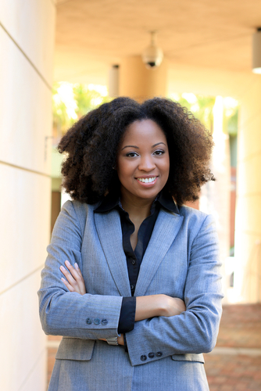
Professionalism
Is a specific style of behavior in the workplace
Is performing in a manner appropriate for the profession and workplace
Can be conveyed through dress, speech and manners appropriate to the profession

Slide 10
Professionalism Skills
Can be implemented through:
dressing and grooming appropriately
creates a first impression
proper grooming and appearance demonstrates respect and shows an individual is taking the job seriously
speech
proper speech can show an individual as mature, intelligent, confident and professional

Slide 11
Professionalism Skills
Can be implemented through:
mannerisms
style of speaking or behaving
method of interacting with others respectfully, courteously and with dignity in the office or workplace

Slide 12
Professionalism Example
Jane dresses according to the employee handbook and participates actively in group conversations presenting herself with integrity
John wears shorts and ball caps to work, speaks with sarcasm and does not take his job seriously
Which of the two is acting with more professionalism?

Slide 13
Effective Communication
Is possibly the most important skill in the workplace
Is transferring information from one place to another, whether it is vocally, written, visually or non-verbally
good interpersonal communication skills allow individuals to work more efficiently in groups

Slide 14
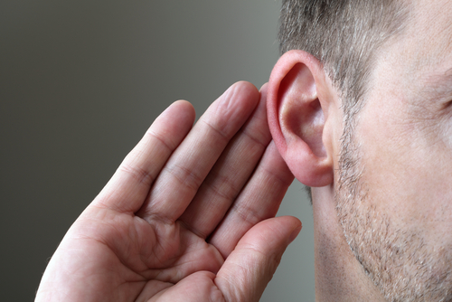
Effective Communication Skills
Can be implemented through:
effective speaking
being prepared, engaged and practiced
active listening
making a conscious effort to hear and understand what people are saying

Slide 15
Effective Communication Skills
Can be implemented through:
writing
using correct grammar, punctuation and spelling
includes items such as memos, reports, e-mails and faxes
non-verbal communication
using body language, eye contact and facial expressions to show interest in the conversation
making non-verbal communication agree with verbal communication

Slide 16
Effective Communication Example
Jane is an active listener using body language to show she is interested in the conversation
John does not seem to pay attention to the speaker and never proofreads his memos, e-mails or business letters for correct grammar, punctuation and spelling
Which of the two have better communication skills?

Slide 17
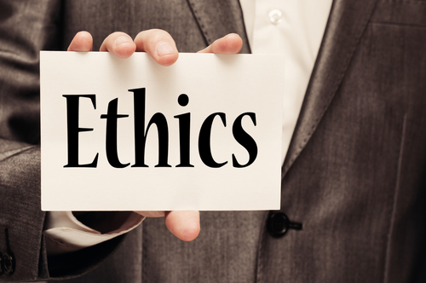
Ethical Behaviors
Are values or standards which direct the way individuals live
Govern the way people behave towards family members, employers, supervisors, co-workers and customers

Slide 18
Ethical Behaviors
Often provide job advancement opportunities and may include the following employee practices:
regular attendance
wearing proper attire
providing a clean and safe environment
taking pride in work
flexibility
taking initiative

Slide 19
Ethical Skills
Can be implemented through:
productivity
demonstrating positive and productive work habits by performing assigned tasks efficiently
reliability and dependability
arriving at work on-time and successfully completing the tasks assigned
dedication
striving to ensure a quality performance, such as putting in extra hours beyond what is expected

Slide 20
Ethical Skills
Can be implemented through:
cooperation
putting effort into working well with others
character
being self-disciplined, pushing to complete work responsibilities, being honest and dependable and representing these positive traits daily
initiative
beginning a process or project without direct managerial influence, sharing ideas and helping to improve the business

Slide 21
Ethical Skills
Can be implemented through:
positive attitude
being appreciative, recharging yourself, volunteering and avoiding negative work attitudes

Slide 22
Ethical Skills Example
Jane has appropriate relationships with all colleagues and exhibits a positive attitude and is willing to help out others
John uses unfair behavior towards employees, abuses cell phone and Internet usage and calls in sick when he is not sick
Which employee practices more ethical behavior?

Slide 23
Academic Preparation
Is required for professional advancement
Consists of the desire and ability for life-long learning
May require the following:
certifications
licensure
registration
continuing education
advanced degrees

Slide 24
Academic Preparation Skills
Can be implemented through:
obtaining necessary or beneficial licensures and or certifications
preparing for a career by learning job-related skills
joining professional organizations
collaborating with other professionals in a field to better understand what skills are required

Slide 25
Academic Preparation Skills
Can be implemented through:
attending continuing education classes and tutorials
finding relevant and beneficial continuing education which applies to a selected career
identifying new technologies and methods of improving

Slide 26
Academic Preparation Skills
Can be implemented through:
working on projects
creating and following a plan while keeping a timed schedule
working in groups
learning teamwork strategies and taking responsibility for an assigned portion of the project

Slide 27
Academic Preparation Example
Jane has joined a professional organization, receives a publication detailing new advancements in her field and attends continuing education courses occasionally
John is the last to learn of changes related to his profession and company
Who is utilizing academic preparation skills?

Slide 28
Critical Thinking
Is being able to evaluate arguments and information quickly, solve problems creatively and identify mistakes with efficiency
Is developing more ideas and making fewer mistakes

Slide 29
Critical Thinking Skills
Can be implemented through:
identifying the elements
recognizing the questions which relate to goals, purpose and needs
collaboration
knowing how to assess information and analyze it for validity and relevance with team members

Slide 30
Critical Thinking Skills
Can be implemented through:
breaking new ground
developing new innovative ideas
creating a final product
using a critical eye and a willingness to look for flaws to ensure a quality product

Slide 31
Critical Thinking Skills
Can be implemented through:
looking at conflict objectively
step back and away from the conflict and look at the facts, recognize assumptions and alternative viewpoints
focusing on the problem and not people
separate a problem from people and moderate the resolution process

Slide 32
Critical Thinking Example
Jane remains relevant to the point, seeks information as well as precision in information and is open-minded to new ideas
John does not take the entire situation into account, uses the first thought which comes to mind and searches for short-term solutions
Which of the two is using beneficial critical thinking skills?

Slide 33
Problem Solving
Requires gathering reliable information, assessing the information for answers and selecting a suitable solution based on the situation
every job will present problems which must be solved effectively and efficiently
Is especially helpful in management and customer service professions

Slide 34
Problem Solving Skills
Can be implemented through:
developing a process
making decisions by creating a step-by-step process which allows an employee to work through problems in a systematic way
anticipating problems
resolving problems through planning, negotiation or by devising a new approach to correcting the problem

Slide 35
Problem Solving Skills
Can be implemented through:
brainstorming
coming up with as many solutions as possible
trial and error
trying out all of the possible solutions and ruling out those which do not work
experience
using solutions which have worked in the past

Slide 36
Problem Solving Example
Jane take initiative and implements a plan to solve a problem and brings about a positive result
John panics and gives up when presented with a problem
Who is the better problem solver?

Slide 37
Teamwork
Is working effectively and efficiently with others
allows tasks to be completed quickly and accurately, allowing a company to take on more work and generate more revenue
Can lead to positive working relationships, improved working environments and a decrease in stress both at home and in the workplace

Slide 38
Teamwork Skills
Can be implemented through:
collaboration
knowing how to assess information and analyze it for validity and relevance with team members
conflict resolution
setting aside personal emotions and finding an answer which benefits each position allowing a fair decisions which benefits the company as a whole

Slide 39
Teamwork Skills
Can be implemented through:
reliability
understanding roles and responsibilities within the group and making an effort to implement them successfully
differing points of view
bringing together different view points helps create solutions to an issue

Slide 40
Teamwork Example
Jane is an effective team member by clearly explaining her ideas to the group and listening carefully to the ideas of others
John sits back in a group, lets others make the decisions and does not speak up if he has an opinion
Which of the two is demonstrating positive teamwork?

