Slide 1
Google Drive List
Chapter 8

Slide 2
Objectives
Create a folder in Google Drive.
Share a Google Drive folder.
Upload files to Google Drive.
Search for items in Google Drive.

Slide 3
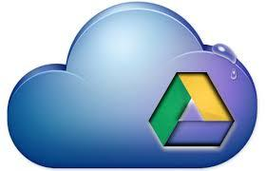
Using Google Drive
Cloud-based Storage
A cloud is a web-based location where a user can store files and create folders that can be accessed from anywhere with an Internet connection.
What is Google Drive?
A cloud-based service provided by Google used to store different types of files.
Docs, Sheets, Slides, Forms, Drawings
Can also save non-Google files that the user uploads.

Slide 4
Using Google Drive (cont.)
How can Drive be accessed?
By logging into a personal Gmail account through a web browser
Google Drive app on a mobile device
Download and install the Google Drive application to a personal computer
Files can be created and then dragged and dropped into the application to copy them to Drive.
Once files are dropped into the application, they will sync across all devices and will appear in your My Drive.

Slide 5
Navigating Google Drive
The Drive Page
To access Google Drive, click on the Apps button in the top right corner of the page to open the Drive page.
The Drive page is displayed in two possible ways:
separate tab
separate window
Used for easy navigation between files and folders

Slide 6
Navigating Google Drive (cont.)
Files and Folders
Files and folders are displayed in the main area of the Drive page.
Files and displayed in two ways:
List view - shows as a listing of each file and folder with information about each.
Grid view - shows as a visual representation of each file.
Users can open, share, organize, remove, and preview files from Google Drive.
To select a file or folder, check the box to the left of the file.

Slide 7
Navigating Google Drive (cont.)
Once a file or folder is selected, action buttons are displayed along the top of the Drive page.
Share
Move to
Delete
More Actions

Slide 8
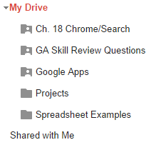
Navigating Google Drive (cont.)
Creating and Sharing Folders
An alternative to using default labels are creating folders.
Folders - virtual containers that can hold files or subfolders.
Subfolders - folders within a parent (main) folder.
Folders (unlike files) are displayed under the “My Drive” label.
My Drive
Folder

Slide 9
Navigating Google Drive (cont.)
Folders can be shared.
Shared Folder - a folder that has been set up so other uses can access it and its content.
When a user shares a folder, the user determines the visibility and level of access of the folder.
All files within a folder, and files added to the folder, will be shared.
If a folder is shared, the folder icon displays a silhouette of a person.
Shared Folder

Slide 10
Navigating Google Drive (cont.)
Folder Visibility
Public - anyone with the link, and private
When a folder is public, all of the documents in that folder can appear in anybody’s search results.
Anyone with the link - users must have a direct link to the folder
Will not appear in a Google’s results
Private - is the default setting and allows the folder or file owner to share the document with specific people.
Best for personal documents.

Slide 11
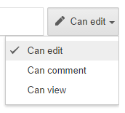
Navigating Google Drive (cont.)
Shared Folder Access
Four types of access when sharing a folder or files:
Owner - the user that can delete a document for all collaborators
Can edit - owner allows another user to add or edit the content of the file
Can comment - people can only comment on the file
Can view - other uses can view the files but not modify or comment on the file.

Slide 12
Navigating Google Drive (cont.)
Searching for Files and Folders
As users create more and more files and folders, the need to quickly search through those files and folders quickly becomes very important.
Quick search box - used to easily locate a file or folder by entering a name or phrase for the item.
Advanced Search - search filters can help narrow down the results
Filters can be set for: file type, level of visibility, or ownership
Search filter - contains criteria defined by the user that limits search results to only those matching the specifications.
Search Operators - “”, OR, before YYYY-MM-DD, to: e-mail address, etc.

